Slide 1
Design For Electrical and Computer Engineers

Slide 2
Class Details
Credits:
Prereqs:
Instructor and contact info

Slide 3
3x5 cards
List
Name
Major
Objectives for this class
Questions you have
Anything I should know.

Slide 4
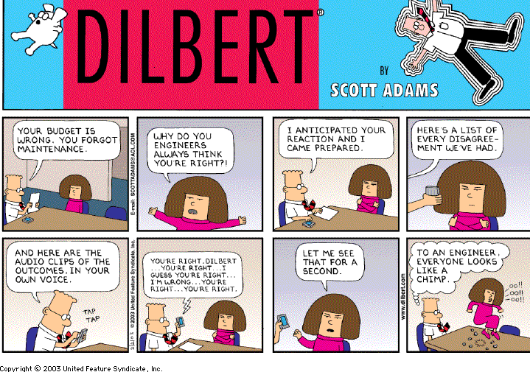

Slide 5
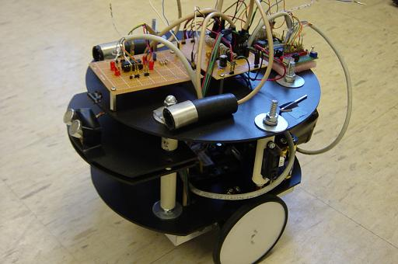
Robot Competition

Slide 6
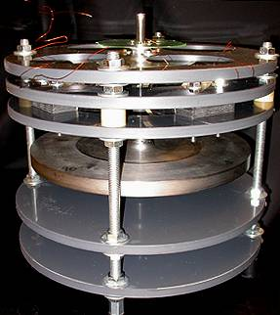
Flywheel Energy Storage

Slide 7
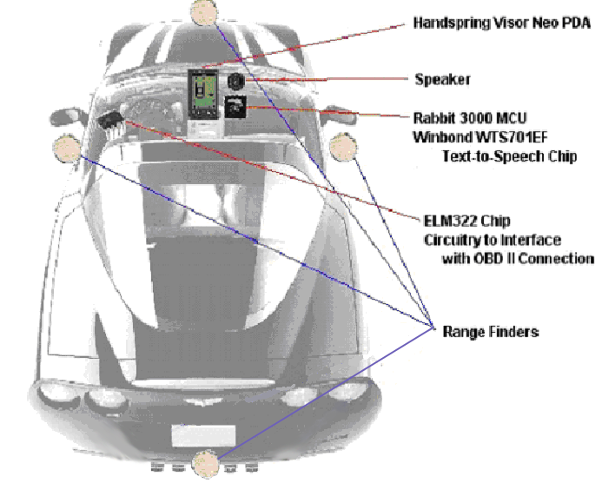
Vision Enhanced Car

Slide 8
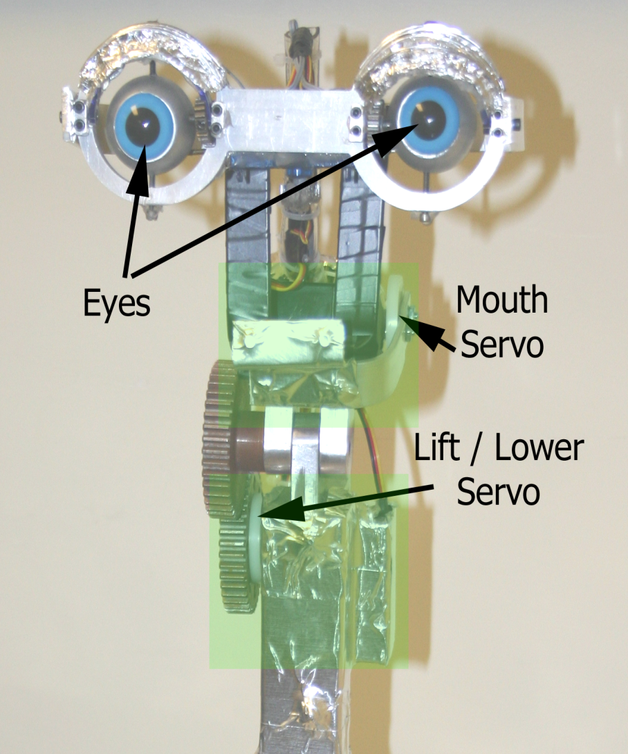
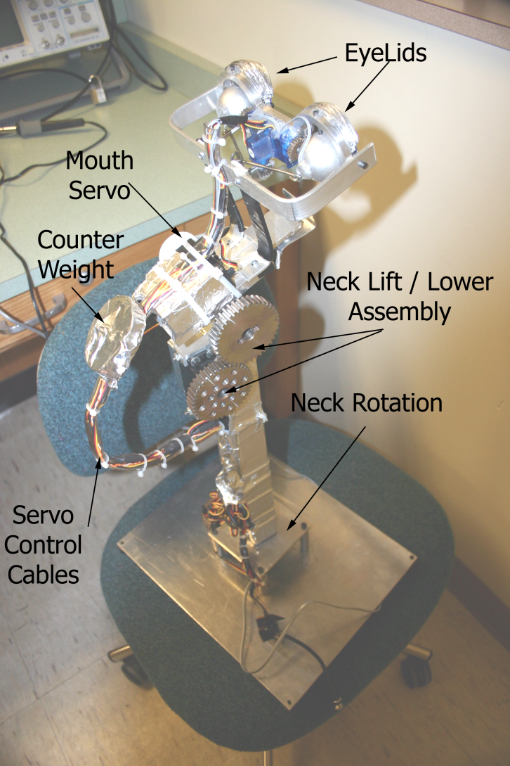

Slide 9
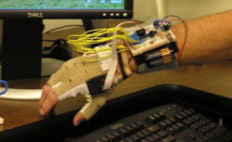
The Rouse

Slide 10
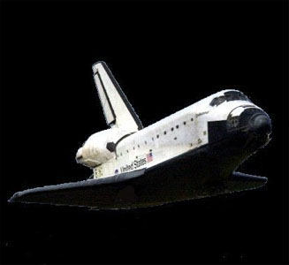

Slide 11
Course Vision
Design Process
Project Excellence
Design Tools
Professional Skills

Slide 12
Text, website & references
Design for Electrical and Computer Engineers: Concepts and Practice by Ralph M. Ford and Chris Coulston, 2008.

Slide 13
Policies
Assignments.
Exams & Quizzes.
Class Attendance.
Academic Integrity

Slide 14
About me
Stuff about you

Slide 15
I hope this class
Will be different from many you have had.
Will be fun.
Will challenge you and cause some stress.
Will help you become a better team player.
Be important in your preparation for a professional career.
Will maintain Behrend’s tradition of excellent senior projects!

Slide 16
I
Want to help you learn.
The best learning is done when you have to work for it – it has got to take some work on your part to get the answer.
Will focus on process and attempt help you become a good engineer as opposed to filling your head with facts.

Slide 17
Assignment
On LMS
Read Chapter #1 by Thursday
Personal Resume – post on LMS

Slide 18
Career Development
What do employers want?
Notes:
Let’s brainstorm

Slide 19
Boeing ENGINEEERING Employment Checklist
Good grasp of engineering fundamentals
Mathematics (including statistics)
Physical & life sciences
Domain knowledge
A good understanding of DESIGN and manufacturing
Understanding of context in which DESIGN is practiced.
Business practices
Economics
History
Environment

Slide 20
Boeing ENGINEEERING Employment Checklist, cont’d
A multi-disciplinary systems perspective.
Good communication skills
Written
Verbal
Listening
High ethical standards.
Ability to think critically and creatively.
Work independently and cooperatively.
Flexible. Self-confident and able to change.
A profound understanding of the importance of teamwork.

Slide 21
Fisher & Parente Study
A more recent Penn State Behrend study of Fortune 1000 companies by Ken Fisher and Diane Parente found that employers want:
Project management.
Communication& team skills.
Quality management practices.
Ethics.
Economics & financial issues (5 years out).

